Slide 1
Counting and recognizing non-moving objects by means of image processing
ESAT 1A1
Co-titular: Tinne Tuytelaars
Coaches: Xuanli Chen & José Oramas
Realised by: Max Beerten, Brent De Bleser, Wouter Devos,
Ben Fidlers, Simon Gulix, Tom Kerkhofs

Slide 2
Table of contents

Slide 3
Test

Slide 4
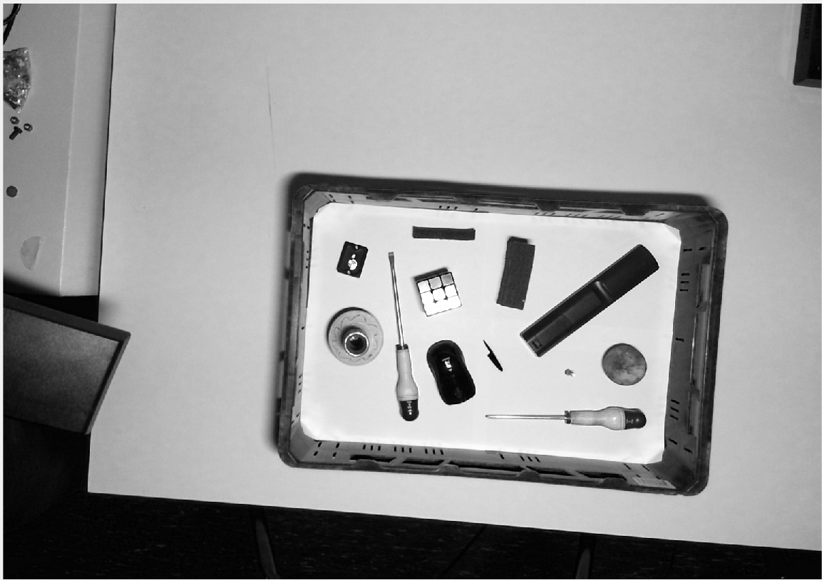
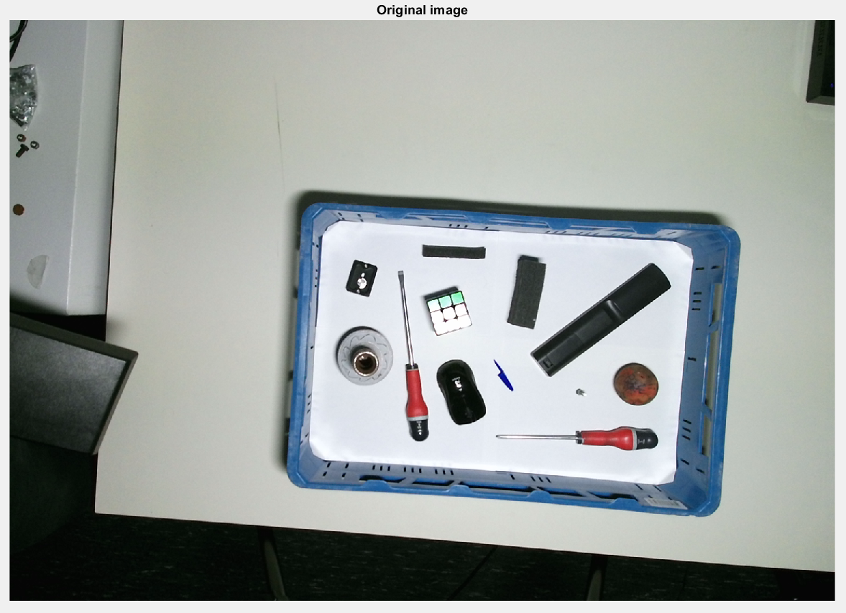
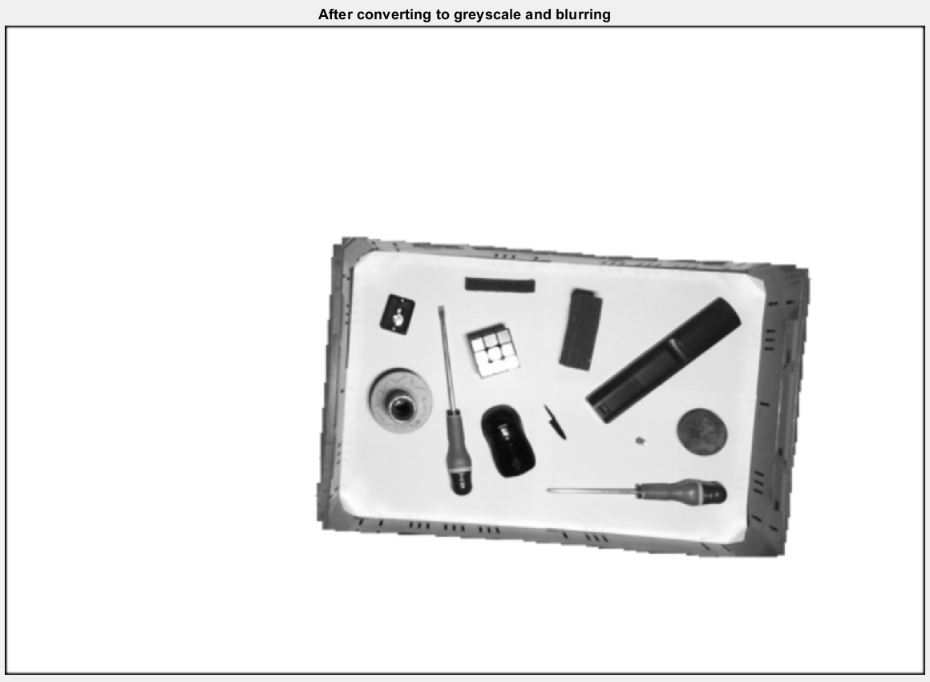
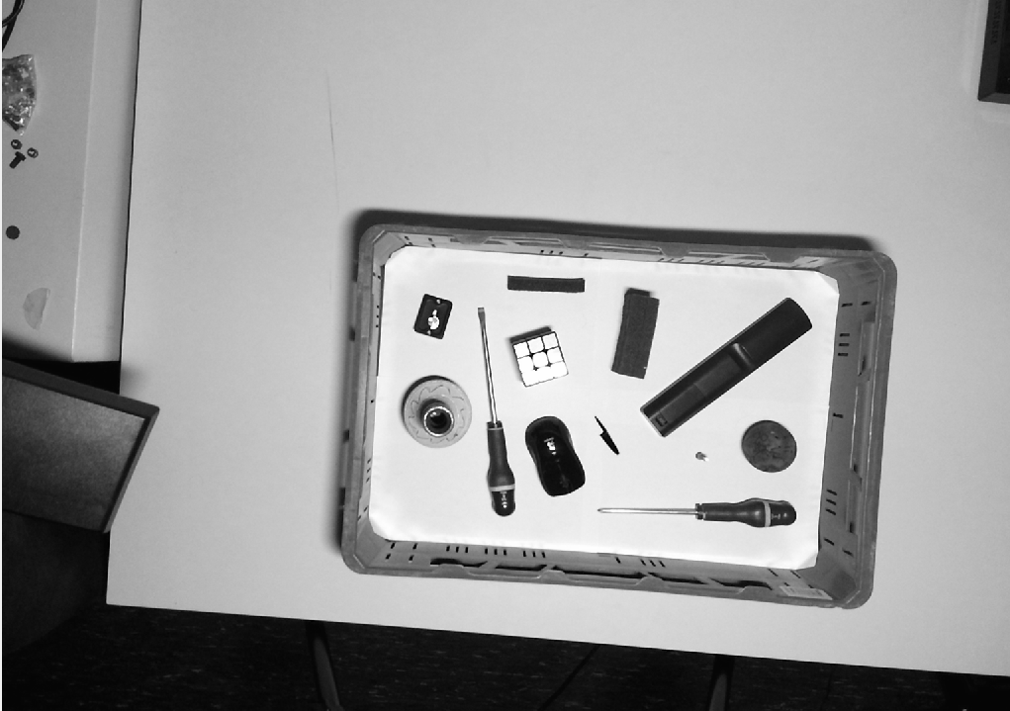
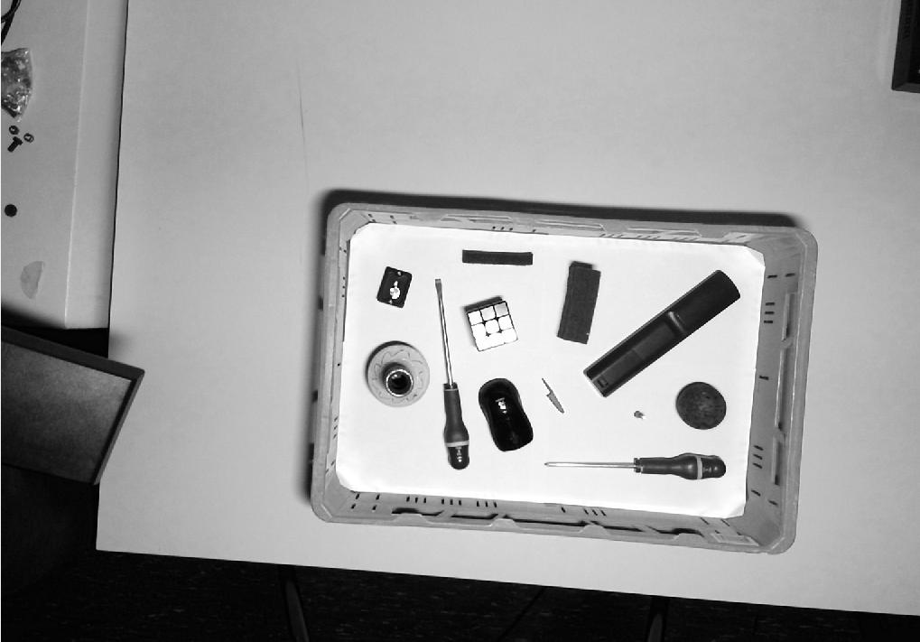
Step 1: Converting to greyscale
Red
0.2989
Green
0.5870
0.1140
Blue

Slide 5
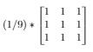
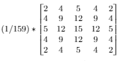
Step 2: Blurring
First a mean blur, than a gaussian blur.
Mean kernel
Gaussian kernel
*
*

Slide 6
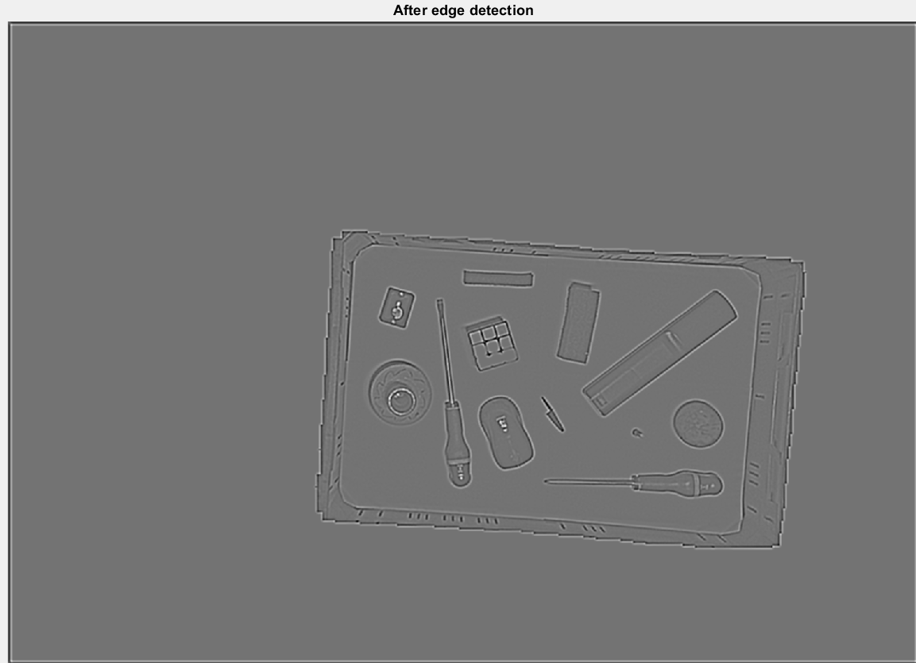
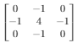
Step 3: Edge detection
*
=

Slide 7
Problem with convolutions
0
0
0
0
0
0
0
0
0
0
00000000000000
Remove_boundary()

Slide 8
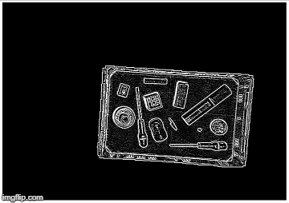
Step 4: Thresholding edge
Notice the white border

Slide 9

Step 5: Grouping

Slide 10
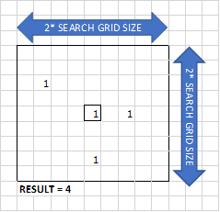
Loop through every pixel:
Check if pixel is black
Count same pixels values in grid
Check if that amount of pixels is big enough
Search for group number in grid (No group found? -> assign new group number)
Place group number in matrix

Slide 11
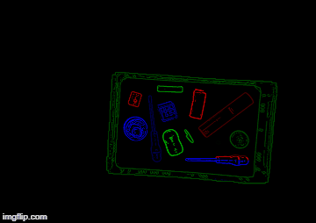
Step 6: Regrouping
Loop through every pixel (right-top to left-bottom)
Check if group number is not 0.
Check if there is another group in the X-pixels below this pixel.
Replace group number of the bottom group with the top group number.

Slide 12
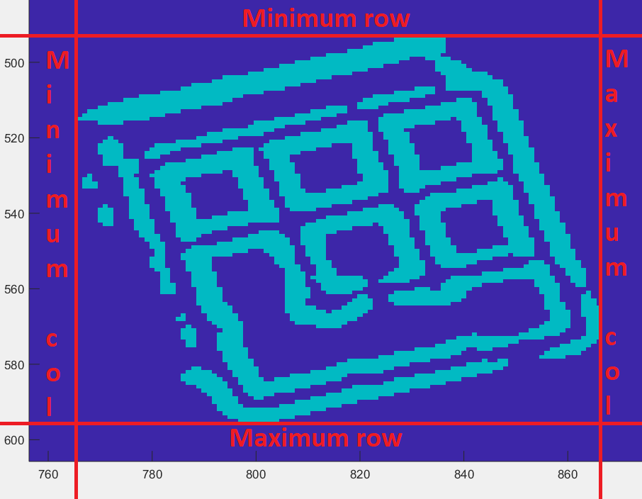
Step 7: Drawing boundary boxes

